Slide 1
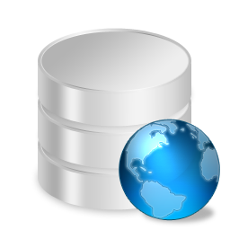

Database concepts

Slide 2

Contents
Data & Information
What is a Database……?
Why do we need a database…?
File Management Systems
Database Systems
Database Management Systems(DBMS)
Relational Database System(RDBMS)

Slide 3
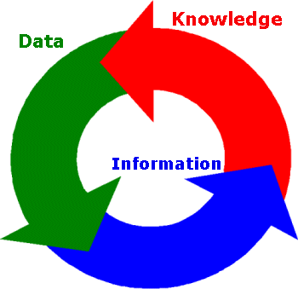
What is a Data & Information..?
Data refers to the lowest abstract or a raw input which when processed or arranged makes meaningful output.
    a price or the name of a product such as milk.
The word ‘data’ is a plural Latin word but it is generally used as a singular word in English.
Information links two or more items
of data to give knowledge.

Slide 4
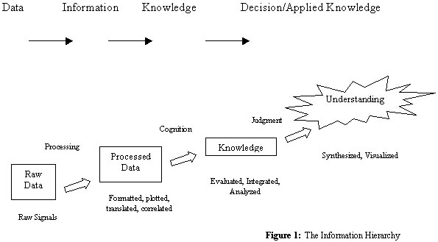
Data & Information

Slide 5
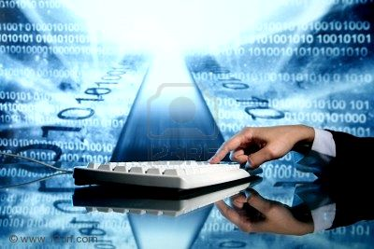
Data & Information
Data has greater importance than the programs
Consider the following reasons:
    Data persists much longer than the programs that operate on it.
    Data may last centuries, the average
    computer application may be expected to last approximately five years before it is rewritten or completely replaced.

Slide 6

Data & Information
Vast amounts of data exist about each of us.
This data is stored in databases and can be analyzed
  e.g. supermarket loyalty cards which can be used to monitor shopping trends or promote sales in certain areas.
More sensitive data includes:
    Secure Data: Like financial data and examination papers. This data is subject to authorization restrictions, as it must only be manipulated by certain people and programs.
    Private Data: Examples of private data include health, employment, credit and criminal records.
The Internet is a good example of a global data resource.

Slide 7
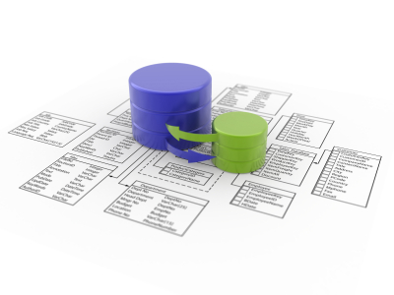
What is a Database……?
A database is a separate application that stores a collection of data.
Some famous definitions for database are:
  A set of information held in a computer
Oxford English Dictionary
  One or more large structured sets of persistent data, usually associated with software to update and query the data
      Free On-Line Dictionary of Computing
  A collection of data arranged for ease and speed of search and retrieval
Dictionary.com

Slide 8
Why do we need a database?
The databases are used to store these large amounts of data or information.
Share data of all kinds between users,
Share between different computers
Several users and/or several tools must be able to safely access the same data concurrently.
Reduced updating errors and increased consistency
Improved data access to users through use
of host and query languages
Reduced data entry, storage, and retrieval costs

Slide 9
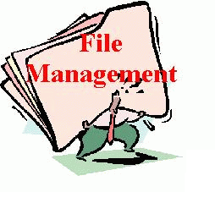
File Management Systems
A File Management System (FMS) is a Database Management System that allows access to single files or tables at a time.
FMS’s accommodate flat files that have no relation to other files.
Problems:
    No standards
    Data duplication
    Data dependence
    No way to generate ad hoc queries
    No provision for security, recovery,
    concurrency,…

Slide 10
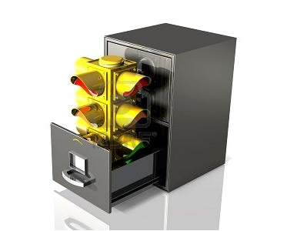
File Based Systems
Data can be stored in files.
Files need to store a number of different types of data, for example characters, integers or more significant structures such as employee records.
The items can be organized in several different ways
  Sequential file
  Indexed sequential file
  Hash file
The COBOL programming language was enormously successful in the 1970s and 80s, as its design aimed for easy handling of files.

Slide 11
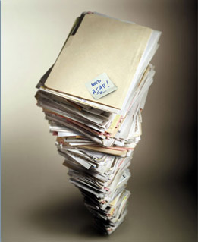
Problems with File-based Systems
Changes in the format of the data force changes in the programs that act on the data - this is termed data dependence.
It is hard to find a single file
This often leads to a duplication of data
to satisfy different users and different applications
Once duplicate data is present this leads
to the possibility of data inconsistency if
one instance of the data is updated and
others are not.

Slide 12
Advantages & Disadvantages
Advantages | Disadvantages
Simpler to use | Typically does not support multi-user access
Less expensive· | Limited to smaller databases
Fits the needs of many small businesses and home users | Limited functionality (i.e. no support for complicated transactions, recovery, etc.)
Popular FMS’s are packaged along with the operating systems of personal computers (i.e. Microsoft Card file and Microsoft Works) | Decentralization of data
Good for database solutions for hand held devices such as Palm Pilot | Redundancy and Integrity issues

Slide 13
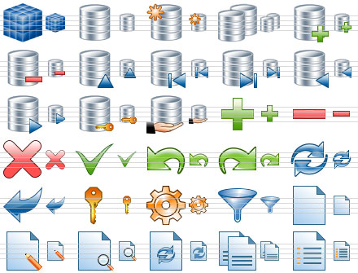
Database Systems
A database system consists of
  Data (the database)
  Software
  Hardware
  Users
Database systems allow users to
  Store
  Update
  Retrieve
  Organise
  Protect

Slide 14
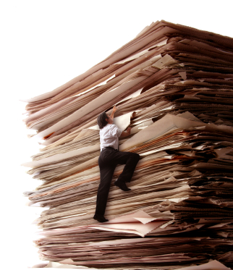
Problems with File-based Systems
There is duplication of functionality across the programs that manipulate the files, as they each need to re-implement:
  Concurrency Control: otherwise simultaneous
  reading and writing of files can corrupt data.
  Recovery: computer crashes during updates
  are likely to corrupt data.
  Integrity: otherwise data may become inconsistent.
  Security: otherwise unauthorized people may change the data.

Slide 15
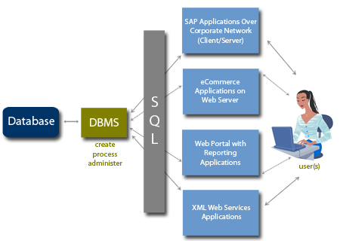
Database Management Systems
A Database Management System (DBMS) is a set of computer programs that controls the creation, maintenance, and the use of a database
The use of integrated collection of data records and files known as databases
Examples:
  Oracle
  DB2 (IBM)
  MS SQL Server
  MS Access
  Ingres
  PostgreSQL
  MySQL

Slide 16
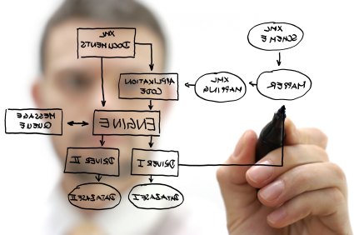
Relational Database System
Store and manage huge volume of data.
The system supports a tabular structure for the data,
In Relational Systems information is stored as tuples or records in relations or tables
Guarantees the Referential Integrity between rows of various tables.
Updates the indexes automatically.
Interprets an SQL query and combines
information from various tables.

Slide 17
Review
Data and Information
Database
File Management System
    Problems
Database Systems
Database Management Systems(DBMS)
Relational Database Management Systems(RDBMS)

Slide 18

QUESTIONS

Slide 19


